Slide 1

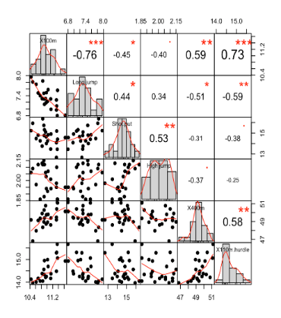
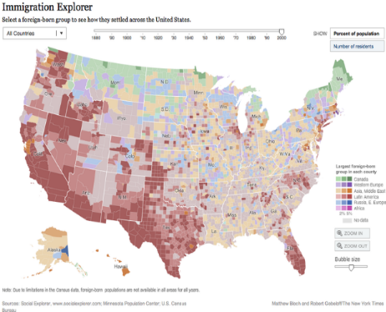
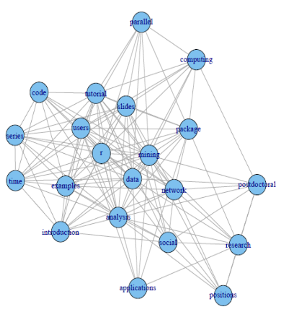
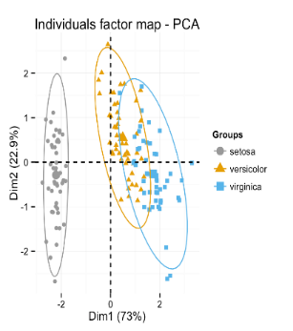
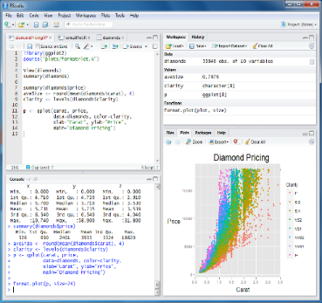
R for beginners training course Guillaume Bal & Yves Reecht https://github.com/GuillaumeBal/r.training September 2018

Slide 2
GETTING STARTED
Coding generalities R basics

Slide 3
1.1 Coding generalities What is a code Code Vs clicks Common base elements Languages

Slide 4

Code or program
Series of commands
you give to your computer
to perform a task (simple or complicated)
Code is like giving a recipe or directions
ORDER MATTERS

Slide 5

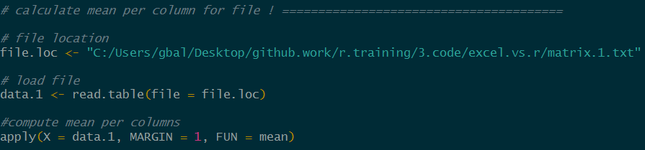
Code (R) Vs clicks (Excel) Similarities
All steps in excel translate as command lines
Ex : calculate the mean per column from a file
Get ‘to’ file location
Open file
Compute the means

Slide 6
Code (R) Vs clicks (Excel) Differences
Example:
For 100 files (with different number row and columns)
calculate the mean per column
store in new file
Get ‘to’ files location
Open file
Compute mean
Include in new file
Write code
Run
100

Slide 7
Code (R) Vs clicks (Excel) Differences
Example
For 100 files (with different number row and columns)
calculate the mean per column
store in new file
R vs Excel
Speed : R / excel = 10min / 50min = .2
Copy pasting errors : 0 with R, time potentially saved ?
program reusable
program easy to share (email)

Slide 8
Why you should use code, summary
Easier automation
Faster computation
Easier to avoid, find and fix errors
Reproducibility (important for detecting errors)
Easier project organization
Version control possible (GIThub)
More powerful data manipulation
Advanced statistics capabilities
Loading of any type of data
Support large data sets
General
‘Data languages’

Slide 9
Common base elements
Inputs / Outputs (interaction with external entities )
loading data
exporting results
Variables: place to hold data in memory with symbolic name
Functions: for executing a task (think executing an action)
Conditionals: execution of task if condition satisfied
Loops: repeating commands

Slide 10
Coding language
Language = medium of communication / interaction
Shared ‘conventions’ to communicate
English, signs, maths… are languages
Coding language = language suitable to interact with computer
Same basics with all languages
Once you get one it is easier to get the next one

Slide 11
1.2 R Basic Console Variables Scripts Functions Rstudio Good practices

Slide 12
What’s R ?
Open source programming language for statistical computing
Derived from S developed in 1993 by the Bell Labs and John Chalmers
Creators : Ross Ihaka and Robert Gentleman (University of Auckland
Project start in 1992, first release 1995, first stable version in 2000
Available at https://www.r-project.org/

Slide 13


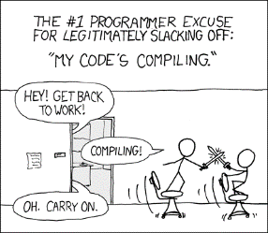
R cons & pros
Steep learning curve
Memory usage
Not always the fastest
No automatic update
Minimal GUI
A few syntactical curiosities
Syntax not always homogenous
Does not compile
Easy to install
Supports 64 bits configurations
‘fairly easy to program’
Developed for data oriented problems
Developed by statisticians for statisticians
High quality analysis
Fortran, C (C++), python wrappers
Open source & cross platform
Free
Huge community (millions users)
100s of packages
Loads of resources (online, books)
Help forum, mailing lists

Slide 14


Aim of the course
Get you started on that journey with R
By learning
How to use the 5 basic coding elements
how to the do most common data manipulating and viewing tasks
How to do a few common analyses (bonus if time)
Then you will be able to keep going on your own

Slide 15

Exercises 1.2-1
Install R
Open R
Google + R download

Slide 16
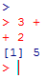
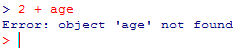
R Console
This is where you write and / or run your commands
2 type of prompts : > and +
Console available
Waiting for command completion
It also displays ‘meaningful’ error messages

Slide 17
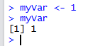
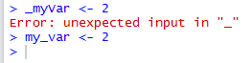
Variable declaration/assignment
Assignment with “ <- ” (“ = “ not recommend, can trigger issues)
Names
start with letter or “.”
followed by letters, digits, “.” and/or “_”
Case sensitive myvar ≠ myVar
Avoid all other characters ($%&{[]}@+-…), they have special meanings

Slide 18
More about the console
Use the upper arrow to scroll through instructions
You can save your session (see menus)
You can clear it with ‘Ctrl+l’
IT IS A PAIN FOR CODING
PEOLE USE SCRIPTS

Slide 19
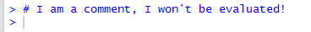
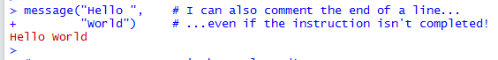
Scripts & comments
A script is a file (usually *.R) containing
a series of instructions (R code, ~computer program)
Loading data
Cleaning/manipulating data
Analyse of data
Export of results
…
AND comments

Slide 20





Graphical User Interfaces
GUI makes R more user friendly and you more productive
GUI are IDE (Integrated Development Environment), i.e. have tools to speed up development
text editor (syntax highlighter, parenthesis checking …),
R command line completion
Data visualization tools …
Most of them are free
NppToR in Notepad++
Tinn-R
JGR
Emacs (for programming freaks)
Rstudio

Slide 21
Started in 2011
Why chose RStudio ?
Graphical workspace
cross-platform interface
tab-completion of filenames, function names and arguments
seamless Rmarkdown and knitr integration for reports
Integrates Shiny for online reports
User friendly, clear, loads of options, cross language…
Updated regularly

Slide 22
Exercises 1.2-2
Install Rstudio
Open it, go through the menus, panels …
Perform few basic math operations in console
Google + Rstudio + download

Slide 23
Exercises 1.2-3
Create a script and save it in your own folder
Create variables
Compute following equation
Store result
a = 2.3, b = 3.5, c = -2, d = 2, e= .011
Y = a*(b + c) + d / e

Slide 24
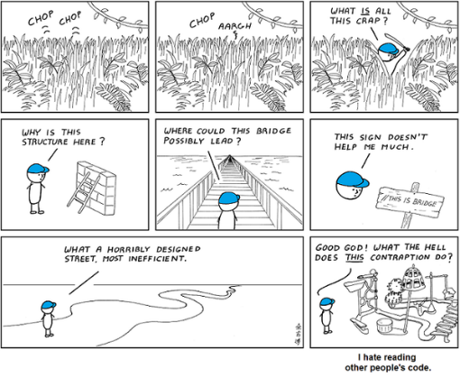
Good coding practices
Use one instruction per line
Use meaningful names
Comment our code
Use # in front of comments
Be descriptive
Indent it too !
(Ctrl + I in RStudio)
Or my own code later

Slide 25
Functions
A function fulfil a task (return a value, print, plot, …)
<function_name>(<arg_name1> = <argument1> , <arg_name2> = <argument2> , ...)
Arguments’ names can be ignored… with caution!
Named arguments
≠
If several arguments, not recommended

Slide 26
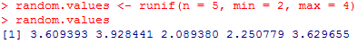
Functions
The result of a function can be stored in variable
You can nest or chain functions
1st function

Slide 27
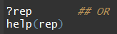
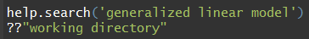
Built in help
If you want help on a specific function, e.g. rep()
If you want to search by keyword in all the functions documentations
Anything more user friendly? HTML browser, with a search tool:
Parameters
Returned value
Examples
…

Slide 28
Exercises 1.2-4
Create a vector using runif()
Compute its mean
Compute its standard deviation
Look for function generating samples from a normal distribution. (topic search)
Repeat steps 1 – 3 with the Normal distribution.

Slide 29
2. R language basic structure
This section will tell you about the basic elements the R language relies upon

Slide 30
2.1 Vectors data types, structure and manipulation

Slide 31
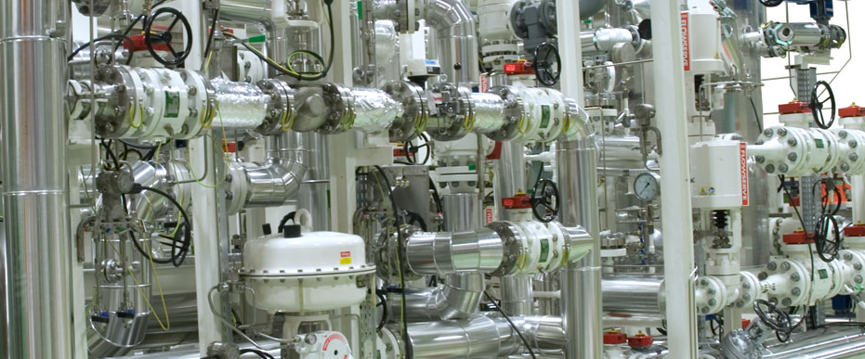

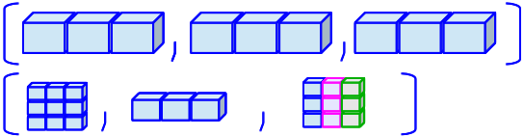
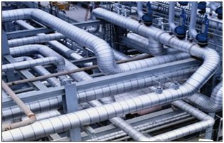
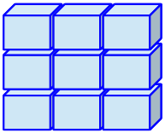
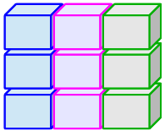
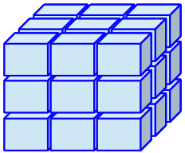
Overview of mains structures in R
# dimensions | Type of data
 | Homogeneous | Heterogeneous
1 | vector | List
2 | matrix | data.frame (tables)
N | array
Data type

Slide 32
2.1.1 Types (modes) of data
Functions mode(), typeof()
Main modes:
numeric: 1, 3.14,… NaN (Not a Number; e.g. 0 / 0) -Inf, Inf (∞) …is the mode reported for types integer and double.
character: "Hello world", 'c\'est la vie',…
logical: TRUE, FALSE
complex: 1 + 2i,…
NA : Not Available (any type).
NULL: ~ empty (e.g. declaration of an empty variable)

Slide 33
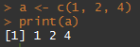
2.1.2 Vector structure
Set of unitary elements of homogeneous type.
The vector is the base structure in R. Even a variable with one element is a vector… notice the [1] (pos. of 1st element on the line)
Every type of data has its own function to create a vector of a given length:
double(<length>), integer(…), numeric(…)
character(<length>)
…
Function concatenate c(…)
length

Slide 34
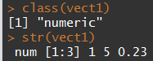
2.1.2 Vector structure (Class)
Function: class(), str()
Note that on a vector, the function class() return the mode!
Other vector-like structures exist…

Slide 35
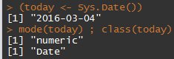
2.1.3 Vector-like structure (class)
factor: a integer vector with a “levels” (names) attribute! extensively used but very confusing (behave either as a numeric or a character… depending on the context)! !!! Plenty of implicit conversions in R
Two more classes that behave like vectors (numeric vectors + attributes to be interpreted as temporal information)
Date:
POSIXct/POSIXlt: date-time.

Slide 36
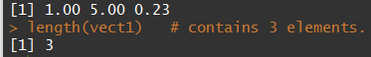
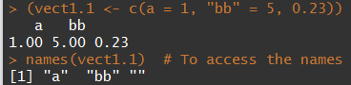
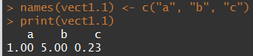
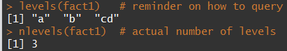
2.1.4 Vectors’ characteristics
How many elements? length()
Names of elements? names()
Levels (factor)? levels(), nlevels()

Slide 37
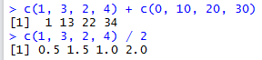
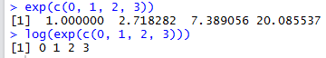
2.1.5 Vectors’ arithmetic
Basic arithmetic operators and functions:
Fully vectorised: allows avoiding most of loops
Operators: + - / * ^
Arithmetic functions: exp(), log(), log10(), sqrt(), abs(), …

Slide 38
Exercises 2.1-1
Create a vector ‘a’ containing the values 10, 5, 4.1 and 100. (function c)
Which is its class? Its mode?
Add 2 to each element of a.
Calculate its log in base 10 (use the help if needed).
Create a vector of two elements with today and yesterday date (use Sys.Date)

Slide 39
2.1.6 Comparisons and tests
operators (guess what… vectorised!)
== (equal): anything that can be compared, character strings, logical, integers, doubles (!!! machine precision).
!= (not equal): anything that can be compared as well.
<, <=, >, >= : numeric, date-time.
Testing for indefinite values:
is.na(), is.null(), is.nan(), is.finite()

Slide 40
2.1.6 Comparisons and tests
sets
is.element(<elements>, <set>) identical to <elements> %in% <set>
Matching positions
which(): position of the TRUE elements.
match(): matches position of elements in the set of values.
See also ?union

Slide 41
Exercises 2.1-2
Create a random vector “x” of length 10, with values comprised between 0 and 10 (function runif(…), use the help).
Which elements of this vector are greater than 5?
Write and store the test
Use which
Test if sqrt(x)^2 equals x in all cases.
Same for sqrt(x^2)
Can you show that sqrt(x)^2 equals x ± the machine precision (use sqrt(.Machine$double.eps) as precision)?

Slide 42
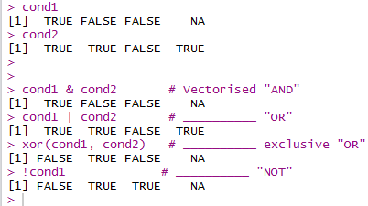
2.1.7 Logical operators
Fully vectorised… as usual & (AND), | (OR), xor (excl. OR) and ! (NOT)

Slide 43
2.1.7 Logical operators
Not vectorised
Among elements of a vector:
any() at least one of the elements is TRUE
all() the elements are TRUE
||, && and isTRUE()
Mainly used for programming control-flow (if clauses in particular). See examples.
isTRUE() returns TRUE if the condition is true, FALSE in all other cases… …regardless it is NA or any other indefinite value.

Slide 44
Exercises 2.1-3
Using the previous vector “x”:
Test if sqrt(x)^2 equals x in all cases (alternative method).
Which elements of x are greater than 8 or less than 4?
Which elements have values between 4 and 8 ?
Extract elements of the vector setLet <- c("A", "b", "Z", "g", "J") which are small caps (reference: predefined vector letters).

Slide 45
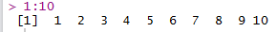
2.1.8 Sequences / repetitions
Very useful for selections, avoiding loops,… examples of use to come later.
seq(…)
works with any combination of (arguments): from=, to=, by= (increment), length.out=, along.with= (vector of same length).
all argument defaults at 1.
shortcuts:
(from)“:” (to)
seq_len(<length>), seq_along(<vector>)

Slide 46
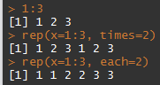
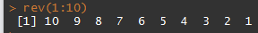
2.1.8 Sequences / repetitions
rep(…): repetition of patterns, sequences,…
rev(…): reverse a vector

Slide 47
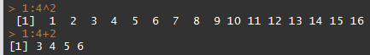
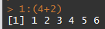
2.1.9 Operators’ precedence
R complies with the usual precedence rules (* / over + -,…)
Some tricky operators (e.g. : )
=> Always use (…) when you have a doubt

Slide 48
Exercises 2.1-4
Create a sequence (function seq) from 2 to 11, with an increment of 3.
Create a sequence starting at 2,
with the length of the vector x (from exercises section 2.2.7 – assume you don’t know its actual length)
with an increment of 1
in two different ways … of which one using “:”!
Create the same sequence using seq_along().
Reverse x and store it in x2.
Create a sequence from 100 to 0 by an increment of 5

Slide 49
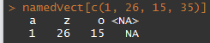
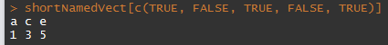
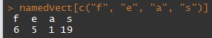
2.1.10 Indexing vector data
How to access/extract a subset of a vector?
several ways, operator […]
position
logical indexation
by name

Slide 50
2.1.10 Indexing vector data
Everything but…
use negative position indices:
=> Elements 1 and 26 suppressed from the output

Slide 51
2.1.11 modification of a subset
How to replace a subset of a vector?
Modify as you access!
several ways, operator […]
position
logical indexation (test)
by name

Slide 52
Exercises 2.1-5
Create a vector “seq5” as a sequence from 2 to 6
Name the elements as the first five letters (from the vector letters). (decompose… first extract the letters,… then change names – names(seq5) <- …)
Select the elements 2 and 4 using two different ways (position / name).
Which elements are greater than 3? (use a test)
How to extract the last element? (suppose you do not know a priori the length of seq5).
Run size <- rnorm(n = 50, mean = 30, sd = 3) Which “individuals” have a size of at least 33? How many are they?
… and replace their value by NA.

Slide 53
2.2 Further data structures

Slide 54
2.2.1 Data types and structure
# dimensions | Type of data
 | Homogeneous | Heterogeneous
1 | vector | List
2 | matrix | data.frame (tables)
N | array

Slide 55
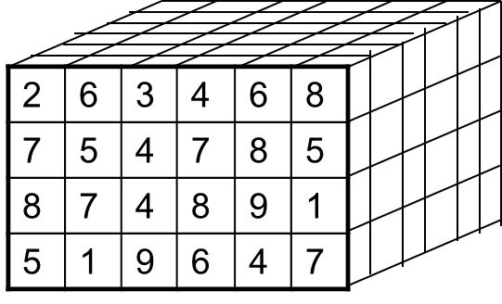
Main classes
matrix: any mode suitable for a vector + 2 dimensions.
dimensions can be named
matrix algebra fully supported in R.
created by matrix(…), cbind(…), rbind(…)
array: ~ same as matrix but not limited in dimensions.
Rows
Columns

Slide 56
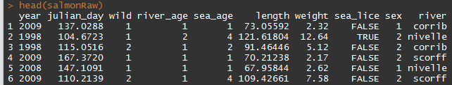
Main classes (continued)
list: catchall structure.
Each element can be of any class or NULL.
The elements can be named.
data.frame: table with different types of data
a type of list (all elements have the same length) 1 column ≈ 1 vector.
two dimensions (rows x cols).
extensively used for ecological data.
!!! characters systematically converted in factors by default!
Rows
Columns

Slide 57
2.2.2 Matrices’ algebra
R is well suited for matrix computations.
Several dedicated operators and functions … see examples

Slide 58
2.2.3 Accessing some attributes
 | 1 dimension (vector, list,…) | 2 dimensions (matrix, data.frame,…)
Number of elements | length(x) | dim(x)* (both dim at the same time) nrow(x) ncol(x)
Names of elements | names(x) | dimnames(x)*(both dim at the same time) colnames(x) row.names(x)
Levels (factors) | levels(x) nlevels(x)
* Can be also used with >2 dimensions.

Slide 59
Exercises 2.2-1
Creating a data frame (heterogeneous data table)
Create a variable people based on the table in .\2.data\1.people\ Use the function: data.frame(name = c("Guillaume", ...), surname = ..., ...)
Print it on the console.
Extract the number of columns.
…and the number of rows.
What are the column names?

Slide 60
3. Data manipulations
Access and modification of particular elements in matrices, data.frames,…

Slide 61
3.1 Indexing data
Access and modification of particular elements in matrices, data.frames,…

Slide 62
3.1 Indexing vector data – Reminder
How to access/extract a subset of a variable?
several ways, operator […]
position
logical indexation
by name

Slide 63
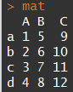
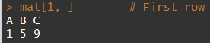
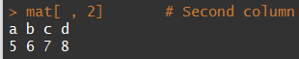
3.2.1 Indexing data with several dimensions
operators […]as well
dimensions separated by “,”
order: rows, columns,…

Slide 64
Exercises 3.2-1
Creating a data frame (heterogeneous data table)
With the table people :
Extract the third column
Extract the fourth row
How to extract the age of the second row?

Slide 65
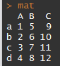
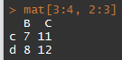
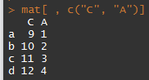
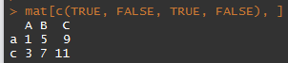
3.2.1 Indexing data with several dimensions
operators […]as well
dimensions separated by “,”
order: rows, columns,…

Slide 66



3.2.1 Indexing data, matrices
Different methods can be combined
R usually tries to simplify by default:
Problem: when programming you not necessarily know a priori the # row or col selected and the behaviour changes if only one. => option drop = FALSE.

Slide 67
3.2.2 Indexing data, lists
Extracting one element
with the position: [[<i>]]
with its name: [["<element_name>"]] or $<element_name>
range of element (!!! returns a list): […] Works just as for a vector: by position, name, logical indexation.
Not for now!

Slide 68


3.2.3 Indexing data, data.frames
data.frames: lists in which every element is a column… + 2 (possibly named) dimensions
2 things to remember
column = vector Dimensions are used just as for matrices:

Slide 69
Exercises 3.2-2
Using the people data.frame
What is the class of the column “section”? (how do you extract a column? Hint: $)
List the different “sections” in the dataset (clue in 2.1.4, 2.2.3).
Create a “new” data.frame (named peopleSub) with only persons from osis and mefss ( %in% ).
How many rows does it contain?
Extract the data for people from feas who are less the 25.

Slide 70




3.3 Modifying data
General rule: “you modify as you access”:
<object>[…] / $… / [[…]] <- value
Also works sometimes for adding/removing stuff:
Adding columns to a data.frame Removing a column

Slide 71


3.3 Modifying data
Further remark: the “change as you access” rule also extends to most of other functions accessing attributes of the objects ([row.|col]names(), levels(),…): … and can even be combined with indices:

Slide 72



3.4 Subsetting data
Using a test
removing elements by position:
subset(x, <condition>) function:

Slide 73
Exercises 3.4-1
Using the people data:
Create a new data.frame “peopleSub6” with the 6 first rows of people.
Remove the column “irish” from peopleSub6.
Select the individuals in peopleSub6 with an “age” greater or equal to 26. Hint: Examples ## 3.4 Cleaning/Subsetting data

Slide 74


3.5 Data types conversion
Including classes that behave like vectors.
Functions as.<type>(…) usable from different compatible types:
Mind the factor’s split personality!

Slide 75

3.5 Data types conversion
Text formatting: for numeric, Dates, POSIXct,… you may want further control => format(…)

Slide 76

3.6 Ordering data
sort() -> order a vector.
order() -> indices to order data (possibly >1 factor)

Slide 77
Exercises 3.6-1
Using the people data
What is the class of the column “name”? Extract the column as a character string (extract and convert). Transform it as a character string (make it permanent).
Extract the sorted ages.
Order people by “section” and “age” and store it in a variable peopleOrdered.

Slide 78
4. Data mining, basics
This section will give you the basics for simple data mining in R

Slide 79
4.1 Importing / exporting
Importing data
Saving data

Slide 80








Data loading
In a nutshell you can load everything you want !
Flat files (simple text files) : read.table() & read.csv() functions
Excel files : packages openxlsx, readxl, gdata, XLConnect, xlsx
https://www.datacamp.com/community/tutorials/r-tutorial-read-excel-into-r?tap_a=5644-dce66f&tap_s=10907-287229
Other statistical softwares: packages haven or foreign (+ Systat and Weka)
Relational data base : package RMySQL, RpostgreSQL, Roracle, DBI
Data from the web : package TwittR2Mongo
(Packages are collections of functions)

Slide 81


Working directory
…where R will look for file, save them, etc.
Query with getwd()
Set with setwd("<path>")
double the \ (windows only) or
use / …for compatibility.

Slide 82

Data loading, read.table()
to read flat file (.txt and .csv)
Import them as data.frame
Quite a lot of arguments (?read.table)
File name, can include location, even online adress
Is the first line of your table variables names ?
Field separator character
Decimal separator character
a character vector of strings which are to be interpreted as NA

Slide 83

Data saving, write.table()
to save your data, quite similar to read.table()
outputs are .txt or .csv. files
Quite a lot of arguments (?write.table)
x, the data you want to save
file name, can include location
field separator character
decimal separator character
row names specification

Slide 84


File location
R does not support \ in addresses
Instead use ‘\\’ or ‘/’
Recommended

Slide 85


Course dataset
Salmons caught in traps (see code)
5 rivers (3 Irish & 2 French)
covers 1995-2015 period
Includes for each fish
river of capture
date
marine and river age
Length(cm) and weight (Kg)
infection by sea lice
SOME ERRORS (inches instead cm…)

Slide 86
Exercises 4.1-1
Import the salmon.raw.data.txt file in R
as a data.frame called ‘salmon.raw’ (use setwd() and read.table())
Display a few rows to check everything is alright (head())
Look at the dimension of the dataframe
Save the data in your folder as ‘salmonRawYourName.txt’
(write.table())

Slide 87
4.2 Basic mining
Looking
Summarizing
Cleaning

Slide 88


4.2.1 Data preview
Because datasets often very large
<object>[…]
head(<object>, n = <nb_elements/rows>)
tail(<object>, n = <nb_elements/rows>)

Slide 89


4.2.2 Data types and summary
Data types/structures
summary(…)
vectors
data.frame

Slide 90


4.2.3 Basic statistics
mean(…), median(…), min/max(…), sum(…), sd(…), var(…),…
!!! NA sensitive: use na.rm = TRUE (if any):
Note on logicals: behave as 0/1 => convenient for summarising tests!

Slide 91

4.2.3 Basic statistics, quantile()
default: quartiles
quantiles can be changed with probs = …

Slide 92

4.2.4 Contingency table, table()

Slide 93
Exercises 4.2-1
Store salmonRaw (or whichever name you stored it in) in a new “salmonTidy” data.frame. You will now work on this data set.
Detect incorrect weights and correct them. Check the mean/min/max weight before/after.
Recode the column “wild” (1 -> TRUE, 0 -> FALSE). Display the number of TRUE/FALSE/NAs.
Save it in a salmonTidy.csv file
Remove entries with impossible dates (ignore leap years).

Slide 94




5. Graphics
This section will tell you about the basic elements the R language relies upon

Slide 95
5.1 Basic graphics
plot(), hist(), boxplot(), barplot(), pairs(), matplot()

Slide 96


plot()
Most basic graphic, displays Y Vs X
See ?plot for more customisation

Slide 97


hist()
Displays histogram
=Graphical representation of the distribution of numerical data
break = argument controling number bars

Slide 98


barplot()
Displays rectangular bars with lengths proportional to the values that they represent
Works on
vectors (regular barplot)
matrices (including contengency tables, stacked barplots)
Legend later

Slide 99


boxplot()
Displays groups of numerical data through their quartiles
You can display a box for different factor levels

Slide 100

matplot()
To display simultaneously multiple
time series
Relationships (mean weight / mean length per river)

Slide 101


pairs()
Displays relationships between all variables of dataframe

Slide 102

Saving graphics
R graphics can be saved as
.pdf files , pdf() function
.tiff files , tiff() function
.png files, png() function
...
Generic way it works
pdf() / tiff() … # ‘start recording’ instruction using
plot() / boxplot() … # all plots you want
dev.off() #‘closure’ instructions using
Arguments needed quite similar for all the kind of outputs

Slide 103
Exercises 5.1-1
Plot length Vs weight of sea.age = 1 fish from Moy river
Histogram weight of fish from Ireland
Boxplot of weight with a box per year
Save some of your graphics
Barplot number of fish per year (contengency table)
Matplot number fish per river per year (if time)

Slide 104
5.2 Customizing graphics
Lines, points, axes and text styles
Plotting area, par()

Slide 105


Features type
With type argument plot function

Slide 106



Points, lines and colours
Points type : pch =
Color : col =
bg = ‘contour color’

Slide 107
More features
You can insert legends with legend()
Add text to the plot using
text()
mtext()
Create custom axes
Set axes = FALSE in plot() or boxplot() or ...
Draw your custom axes using axis()
Add curves, lines, other points
lines()
abline()
curve()
points()
Find the coordinates of points using locator()

Slide 108


More features

Slide 109
Exercises 5.2-1
Plot the length Vs weight of
fish from the Moy river with small points, limit weight axis to 10 (see pch and ylim arguments)
Show us your artsy side, play with the arguments
all fish with a different color per river (see col argument, use river data as numeric)

Slide 110
5.3 Global graphics settings
par()

Slide 111
par(), global parameters
To query graphical parameters
Sets parameters for all subsequent graphics

Slide 112


par(), split graph window
2 argument to specify number of row and colons
mfcol : fill by columns
mfrow : fill by row
Pick one !

Slide 113

par(), margins
inner margin: mar()
outer margins: and oma()
4 values each, start from bottom and clockwise
http://rgraphics.limnology.wisc.edu/rmargins_sf.php

Slide 114
Exercises 5.3-1
use x11() to create new graph windows
Use argument mfrow of par() to allow for 3 graphics
Use argument oma of par() to make really small outer margins
Add 3 graphics on the figure panel (your choice)
Save that panel as a .pdf file

Slide 115

More on graphics
ggplot
Sarah BIGFish talk documents https://bigfish.joomla.com/meetings
http://www.cookbook-r.com/Graphs/Axes_(ggplot2)/
Extra code folder
maps : see Hans course http://bigfish.joomla.com/meetings
http://girke.bioinformatics.ucr.edu/GEN242/vignettes/15_Rgraphics/Rgraphics.html
http://www.r-graph-gallery.com/

Slide 116

6. Repetitive & conditional tasks
How to avoid loops, well because they are
- slow (not always the case)
- because they are more complicated to write
How to make loops when you have no choice

Slide 117
6.1 Applying the same function - over one dimension of a matrix/dataframe/array, apply() - by factor levels on a vector, matrix, dataframe, tapply() & by() (over elements of a list, sapply() and lapply(), see extras section)

Slide 118

Applying across dimensions : apply()
To perform an operation by rows or columns of matrix/dataframe/array
For instance to get quantiles by rows
x, the data you want to use
1 for rows and 2 for columns
The function you want to use
Argument linked to quantile()

Slide 119
Apply functions by factor(s) tapply()
Applies function on vectors only (X argument)
Factor or combination of factors entered as list (INDEX argument)
function to use, no () (FUN argument)
Produces matrix type output

Slide 120
Applying functions by factor(s) by()
Can be used on dataframe (and lists)
Outputs of type list
Allows functions
More complicated and customized
Returning outputs base on several columns of the dataframe
See extras section

Slide 121

Including ‘applied functions’ arguments
When specifying FUN / MARGIN, you may need to include further arguments
You add that / those argument within apply(), by()…
Example, for dealing with NA

Slide 122
Exercises 6.1-1
Subset salmon data for columns year, weight, length & julian.day and store as salmon.num
Use apply() to calculate the mean of the columns
Use apply() to compute quantiles 0.2, 0.4, 0.6, 0.8
Calculate mean size of fish by (use tapply())
year
year and sea age

Slide 123
6.2 loops - for() loop, performs instruction for given number time - nesting loops - if(), for conditional tasks, not a loop but part of nested loops (while() loop, perform instructions while condition is satisfied, see extras section)

Slide 124


for() loops, structure
To repeat a task for a determined number of iterations
Uses counters such as ‘i in 1:n’ (i follows a sequence)
Example
print() needed to display values inside loop

Slide 125







for() loops, when ?
You have to repeat an operation several times (> 3 - 5)
Build series
Loop over dimension(s) of data frame / matrix
You can’t use vectorization or use apply() and the likes

Slide 126
Exercises 6.2-1
Create a for loop with
- an idx value ‘a’ from 1 to 9
printing ‘a’
printing ‘a + 3’ value
printing ‘result = a + 3 value’, for instance ‘result = 5’ (use paste function)
Store results into a vector

Slide 127
Exercises 6.2-2
Save each river of the salmon data into a different ‘.txt’ file
Elements needed (uncover if struggling)
Extract a vector of unique river names ‘unique.rivers’ (unique(…) or levels(…))
Let’s create variable riv <- unique.rivers[1]
Make a subset of data using ‘riv’ and salmon data
Create a file name using paste() function and ‘riv’
Put everything into for a loop with riv as the counter

Slide 128


Add conditional tasks with if()
To perform a task based on a condition / test
Usually within a for() loop

Slide 129


Add conditional tasks with if()
Often you do a different task if condition not satisfied
use else{}
Nothing between
closure if{} and
start else{}

Slide 130
Exercises 6.2-3
Save the salmon data into a different ‘.txt’ file for each river
Create a pdf containing for each column of the salmon data
a boxplot if column being of class numeric (nested if).
add the corresponding column name as title for each graph
Extend previous loop to draw a barplot of frequencies if column not of class numeric
else needed
Need to nest table() and barplot() to draw figures

Slide 131

Nesting loops
You can nest for() loop
Here you loop over both dimension of a matrix
No limits and you can top with conditionals

Slide 132
if() specific options
Specific options, CAREFULL ABOUT THOSE
break() to get out of innermost loop if condition not satisfied
next() allows to go to the next iteration
See examples in code folder

Slide 133


7. More advanced analyses & programming
This section will tell you about
1. creating functions
2. basic analyses of data
Linear models
Y = a + bX + e, e iid

Slide 134
7.1 Creating functions

Slide 135

Functions
function : part of a computer program that performs some specific action
Useful to write one when doing several time the same kind of action
You can create your own !
They return one thing only (but this can be a list)

Slide 136


Sum of 2 integers
Quite simple
But
This would crash a script

Slide 137


Sum of 2 integers, stop()
stop()
stops function execution and give error message
is placed within function body
needs a condition

Slide 138


Sum of 2 integers, warnings()
warning()
display message nut do no stop function
Good to introduce a bit of flexibility

Slide 139
Exercises 7.1-1
Create a ‘power.it’ function
computing a^{b}
Include error message if arguments aren't numbers (stop)
If b negative create warning saying your are computing a root
Add default values (see further for details)
Create a function ‘ratio.as.percent’
Function displays ratio in percentage
Should be rounded to neared %
Outputs should include % sign.
Use stop / warning ….

Slide 140


Adding default arguments’ values
You may need to add default values for arguments
Use arg = NULL, replace arg in function body
Here is a simple example

Slide 141
Further tools for functions
stopifnot()
Like stop but several conditions
try()
Try to run function but does not stop whole script if error
warning()
To return error message without sopping function
debug()
To debug a function

Slide 142


R functions, get details
A function has three attributes

Slide 143
7.2 Quick overview stats

Slide 144
Non parametric smoothing
Used to highlight trends in the data
lowess()
is one function performing smoothing
argument ‘f’ modify the degree of smoothing
For more details and functions see Hans talk at https://bigfish.joomla.com/

Slide 145


lowess() examples

Slide 146
Correlations / linear models
bartlet.test(), test homoscedasticity or homogeneity of variances, one of the main hypothesis
cor.test() , correlation between 2 variables
anova(), comparison of means
lm(), glm() allow for linear regression

Slide 147


cor.test() and lm() example

Slide 148
Generalized Additive Models
Are linear models and smoothers mixed
Model selection need to be performed
MGCV package advised
Hans talk https://bigfish.joomla.com/

Slide 149
Generalized Additive Models
NOT PUBLIC
Window configured with layout()

Slide 150
General-purpose optimization in R
Recommend optmix package
Fits model by
minimising residual sum of squares
minimising deviance (requires writing likelihood)
See code for details (7.4.optimx.r)
Window configured with layout()

Slide 151
7. EXTRAS YOU MAY NEED / USE SOON ...

Slide 152
dates
lubridate package

Slide 153
Other data structures
array: ~ same as matrix but not limited in dimensions.
Like matrices
list: catchall structure.
Each element can be of any class or NULL.
The elements can be named.
Like data.frames

Slide 154
Indexing data, lists
Extracting one element
with the position: [[<i>]]
with its name: [["<element_name>"]] or $<element_name>
range of element (!!! returns a list): […] Works just as for a vector: by position, name, logical indexation.

Slide 155


Applying functions on elements of list
lapply()
returns a list of the same length as X
each element is the result of applying FUN
sapply()
a user friendly version of lapply(), FUN instead of MARGIN
returns a vector or matrix

Slide 156

Applying functions by factor(s) by()

Slide 157

Applying functions by factor(s) by()

Slide 158


while() loop
To repeat an action until condition satisfied

Slide 159

Data loading and saving, excel files
For .csv files see
‘read.table’ and ‘write.table’
‘read.csv’ and ‘write.csv’

Slide 160
ggplot2 package
A package dedicated to graphs
Based on the grammar of graphic approach relying on
Aesthetics, ie what you plot
Geometries, ie how you plot it (points, lines, ribbon…)
According to some people
More intuitive ?
better that basic R graphic functions because you need less code

Slide 161




ggplot2 package, examples

Slide 162


ggplot2 package, examples

Slide 163




ggplot2 package, examples

Slide 164
8. TO KEEP GOING
This section will tell you about
1. potentially useful packages
2. where to learn more

Slide 165
Reports, R markdown package
It is
Package developed by r studio based on knitr and pandoc
Fully integrated in r studio
Useful for
Easily creating dynamic documents
Web pages
Reproducible analysis and reports
Data work up for WGs – html/word
Working Group reports - word
Survey reports – word/pdf
Documenting packages/functions – pdf
See Colm talk at http://bigfish.joomla.com/

Slide 166
R packages
Data manipulation / cleaning
tydr (no obvious advantage)
stringr for string manipulations
dplyr (uses intuitive syntax)
data.table (syntax ‘close’ to SQL, time efficient on big tables)
lubridate (to mess with date formats)
zoo, xts and quantmod (for time series)
Plots
ggplot, ggplot2 (plotting package based on grammar of graphic)
ggvis (interactive web graphic)
Ploty (interactive, browser-based charting library )
Mapping
See Hans talk on http://bigfish.joomla.com/
Reporting
R markdown in Rstudio, see Colm talk on http://bigfish.joomla.com/
Function Sweave to generate LATEX documents and pdf
Package OdfWeave for open office documents
Web application
Shiny

Slide 167
R packages, fisheries
FSA : Fisheries Stock Assessment
FLR : Fisheries Library in R
fishmethods : Fisheries Methods and Models in R
fishdynr : Fisheries Science Related Population Dynamics models
TropFishR : Tropical Fisheries in R …
More on R for fisheries analyses website
http://derekogle.com/fishR/

Slide 168


Write your own models
Optimizers (see before)
nls()
nlminb()
optim()
package optmix include all previous (see code)
Call specialized software using R packages

Slide 169







More help
Books
Forums
http://stats.stackexchange.com/questions/tagged/r
http://r.789695.n4.nabble.com/
Mailing list
R help mailing list, https://stat.ethz.ch/mailman/listinfo/r-help
BIGFish mailing list, bigfish_mailing_list@googlegroups.com
Google
loads of documents
choose you keywords wisely
you’ll probably end up on one of the forums mentioned

Slide 170
More exercises
loops
plot length/weight
by river for every year, all rivers for one year on same panel
save into a pdf
Loop saving 20 matrices in different files
10 rows 10 columns, rnorm(n=)

Slide 171


Slide 172

Why you should keep Excel
https://www.youtube.com/watch?v=OrwBc6PwAcY

